Slide 1
Covid-19
Think Tank Session
May 2020

Slide 2
Agenda
Mission Update
Lessons learned
Financial Impacts

Slide 3
Agenda
Mission Update
Lessons learned
Financial Impacts

Slide 4
Biomedical Services
Canceled drives – 26,000
Equates to 728,000 units
Replaced by inefficient drives
Unpredictable demand
Averted a blood shortage
Seeing a precipitous drop in demand
Expecting major spikes
Drive safety
Social distancing
Safety protocols
Notes:
Updated drives cancelled and units figure pulled from dashboard email sent on morning of 5/2/2020

Slide 5
Convalescent Plasma
Stood up operation in record time
Shipped over 5,000 units
Experimental treatment with some promising results
Will soon perform antibody tests on all donors
Shelf life is longer for plasma than other blood products
Notes:
Total collected: 1491
Mfg WIP: 331
Inventory: 131
Shipped: 883
Total: 1345
52,500 registered on the site
Yield rate low:
2718 appointments/52,500 total registered = ~5%
2718 appointments/12,000 Red Cross qualified donors = ~22%
780 units shipped
2200 appointments pending (future appointments)
Eligibility has improved:
25,000 donors need antibody tests
~ 11,000 of these are Red Cross donors (a Red Cross collection site is convenient to where they live)
The remaining 14,000 will be referred to non-Red Cross sites
Starting to schedule these donors now
Will introduce slowly as % who have antibodies is unknown

Slide 6
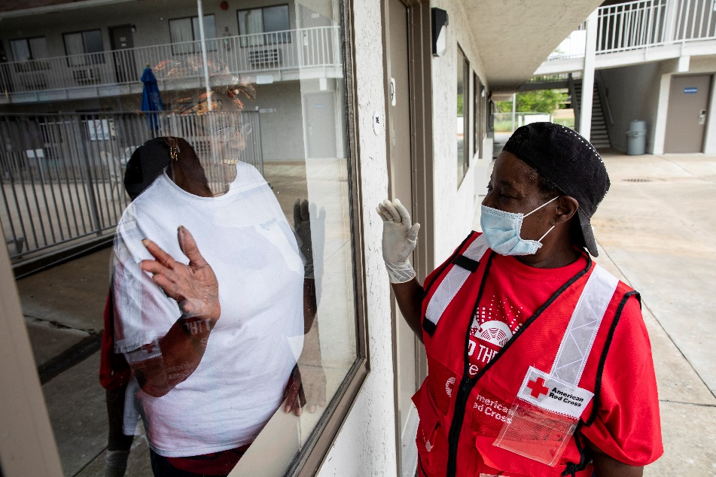
Disaster Services
Made very large changes to disaster protocol
Hotels vs. Shelters
Boxed meals
Virtual volunteers
Social distancing
Home fires
Responded to 200 tornadoes in South/Midwest: 1500 in hotels
Engaged in community feeding programs

Slide 7
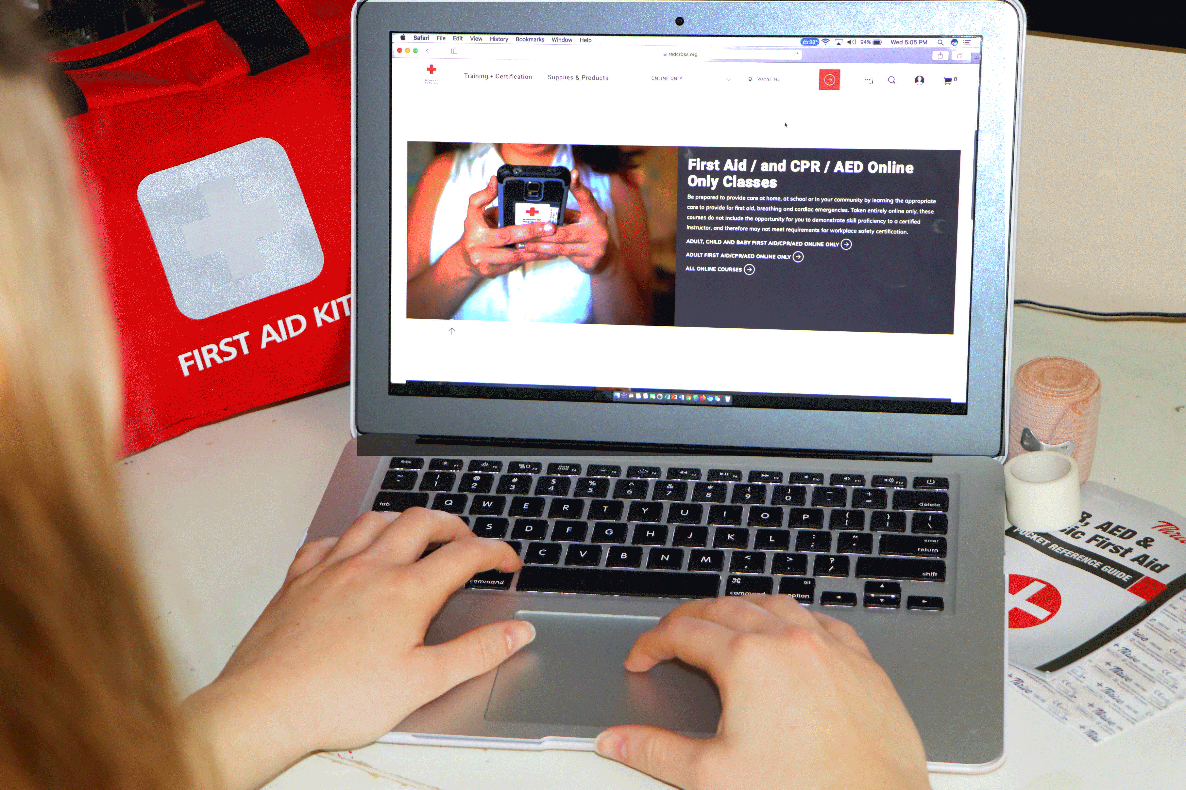
Training Services
To date 4,500 classes canceled
Quickly developing new on-line classes
Mental health First Aid
Social Distancing
Extending certification from 90 to 120 days
Redeploying call center personnel
Notes:
Jack provided 4,546 number on 5/8/20 – I rounded to 4,500
Here is info on the course:
In order to help people build resilience and lend support to others during these difficult times, Training Services has developed a new Mental Health First Aid for COVID-19 course. The course content is based on guidance from the American Red Cross Scientific Advisory Council, the Center for Disease Control and Prevention (CDC), and the American Academy of Pediatrics (AAP). The free online course takes approximately one hour to complete and includes content on recognizing stress as well as caring for yourself while supporting your family and coworkers.

Slide 8
Services to the Armed Forces
Seeing a 15% increase in calls to our calling centers
Our partners reducing financial assistance
Continuing to provide reconnection workshops virtually
Course includes connecting with kids, defusing anger, and a caregiver module
Notes:
Koby provided 15% number on 5/1/20

Slide 9
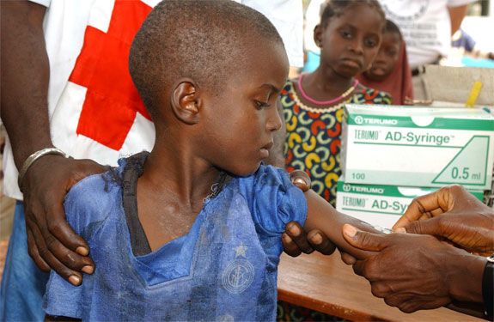
International Services
Programming $10 million USD for COVID-19 initiatives
Assisting with food, water, training, financial aid, PPE, and psycho/social support
Completed a successful measles campaign with 1.9 million children vaccinated
2.9 billion so far
21 million lives saved
Notes:
Koby provided $6.5M number on 5/1/20

Slide 10
Agenda
Mission Update
Lessons learned
Financial Impacts

Slide 11
Lessons Learned
Safety of our employees, volunteers, donors, and clients comes first
The science is evolving and so must we
Our biomed operation can be agile
Virtual care and hotels can work absent a pandemic
We can save costs in travel and real estate
We can operate in an eco-friendly way
Our fundraisers can raise gifts for biomed
Our four-year strategic plan was essential for survival
The Red Cross movement is a powerful force

Slide 12
Agenda
Mission Update
Lessons learned
Financial Impacts

Slide 13
Financial Pressures
Revenue
Suppressed demand for blood
Canceled classes
Expenses
Inefficiencies – smaller drives, more personnel
Sanitizers, masks, gloves, thermometers
Computer equipment
Hotels
Employee programs

Slide 14
gail.mcgovern@redcross.org

